Slide 1

Comprehensive Guide to Data Extraction
A complete walkthrough for efficient data extraction
Notes:
Data extraction is a fundamental process in data analysis and business intelligence. In this presentation, we will provide a comprehensive guide to data extraction, covering topics from the basic concepts of SQL to handling inconsistent or incomplete data.

Slide 2

Topics to be Covered
Using SQL to Extract Data from Relational Databases
Data Formats and Data Types
Notes:
We will start by looking at how to extract data from relational databases using SQL and explore advanced SQL techniques. Then, we will discuss data formats and types, including how to convert between them and handle inconsistent or incomplete data.

Slide 3
Using SQL to Extract Data from Relational Databases
Notes:
SQL is a powerful language that is widely used to extract data from relational databases. In this section, we will explore how to use SQL to extract data from databases, including basic SQL concepts, advanced SQL techniques, and best practices for data extraction.

Slide 4
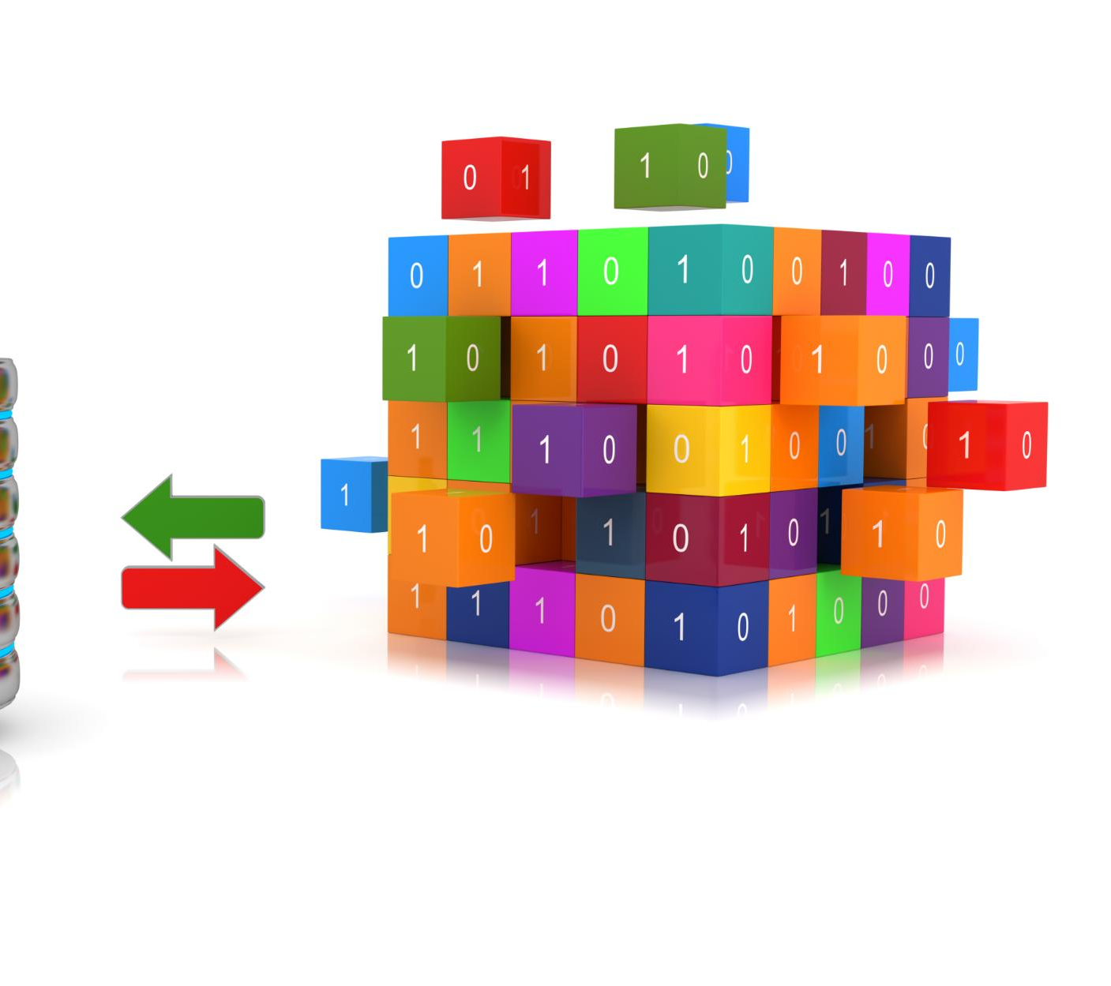
Overview of Relational Databases
  Relational databases store data in tables and use relationships between tables to organize the data. Understanding the structure of a relational database is crucial for effective data extraction.
Notes:
Relational databases are the most common type of database used in data extraction. They store data in tables and use relationships between tables to organize the data. Understanding the structure of a relational database is crucial for effective data extraction.

Slide 5

SQL Basics
Selecting Data
  Selecting data is a fundamental concept in SQL that allows you to retrieve a specific set of data from a database table.
Filtering Data
  Filtering data is another important concept in SQL that allows you to retrieve data based on a specific condition or set of conditions.
Joining Tables
  Joining tables allows you to combine data from multiple tables based on a common column or set of columns.
Notes:
SQL is a declarative programming language that is used to extract data from relational databases. In this section, we will cover basic SQL concepts, including selecting data, filtering data, and joining tables.

Slide 6

Advanced SQL Techniques for Data Extraction
Subqueries
  Subqueries are SQL statements that are nested within another SQL statement and can be used for data extraction, filtering, and aggregation.
Window Functions
  Window functions are a group of advanced SQL techniques that can be used to perform complex calculations, such as ranking, partitioning, and aggregation.
Other Advanced SQL Techniques
  Other advanced SQL techniques for data extraction include pivot tables, stored procedures, and user-defined functions.
Notes:
Advanced SQL techniques can be used to extract data more efficiently and effectively. In this section, we will explore subqueries, window functions, and other advanced SQL techniques that can be used for data extraction.

Slide 7

Data Extraction Best Practices with SQL
Avoiding Cartesian Products
  Cartesian products occur when a query returns a result set with the number of rows that is equal to the product of the number of rows in each table being queried. This can cause significant performance issues and should be avoided.
Query Optimization
  Queries should be optimized to improve performance and reduce the time it takes to extract data. This includes using indexes, avoiding subqueries, and minimizing the number of joins.
Appropriate Data Types
  Using appropriate data types can help ensure the accuracy and integrity of the extracted data. This includes using the correct data types for each column, avoiding NULL values, and validating data inputs.
Notes:
Data extraction can be a complex process, and there are several best practices that can help ensure the accuracy and integrity of the extracted data. In this section, we will cover important best practices, including avoiding Cartesian products, optimizing queries, and using appropriate data types.

Slide 8
Data Formats and Data Types
Notes:
Data formats and types are important concepts in data extraction, as they determine how data is stored and processed. In this section, we will explore common data formats and types, including how to convert between them and handle inconsistent or incomplete data.

Slide 9

Common Data Formats
CSV
  CSV (Comma Separated Values) is a simple and widely used data format that stores tabular data. It is easy to read and write, but doesn't support nested data structures.
JSON
  JSON (JavaScript Object Notation) is a lightweight data format that is easy to read and write. It supports nested data structures and is widely used in web applications.
XML
  XML (Extensible Markup Language) is a data format that is similar to HTML and is used for storing and transferring data. It supports nested data structures and is widely used in enterprise applications.
Notes:
There are several common data formats used in data extraction, including CSV, JSON, and XML. Each format has its advantages and disadvantages, and understanding how to work with each format is important for effective data extraction.

Slide 10

Data Types and Their Significance
Numeric Data Types
  Numeric data types are used to store numbers and can be either integer or floating-point. Understanding the significance of numeric data types is important for performing calculations and data analysis correctly.
String Data Types
  String data types are used to store text and character data. Understanding the significance of string data types is important for working with text data, such as searching, sorting, and formatting.
Boolean Data Types
  Boolean data types are used to store true/false or yes/no values. Understanding the significance of boolean data types is important for logical operations and decision making.
Notes:
Data types are used to specify the type of data that is stored in a variable or field. Understanding data types is important for data extraction, as it determines how the data can be processed and analyzed. In this section, we will cover common data types and their significance.

Slide 11
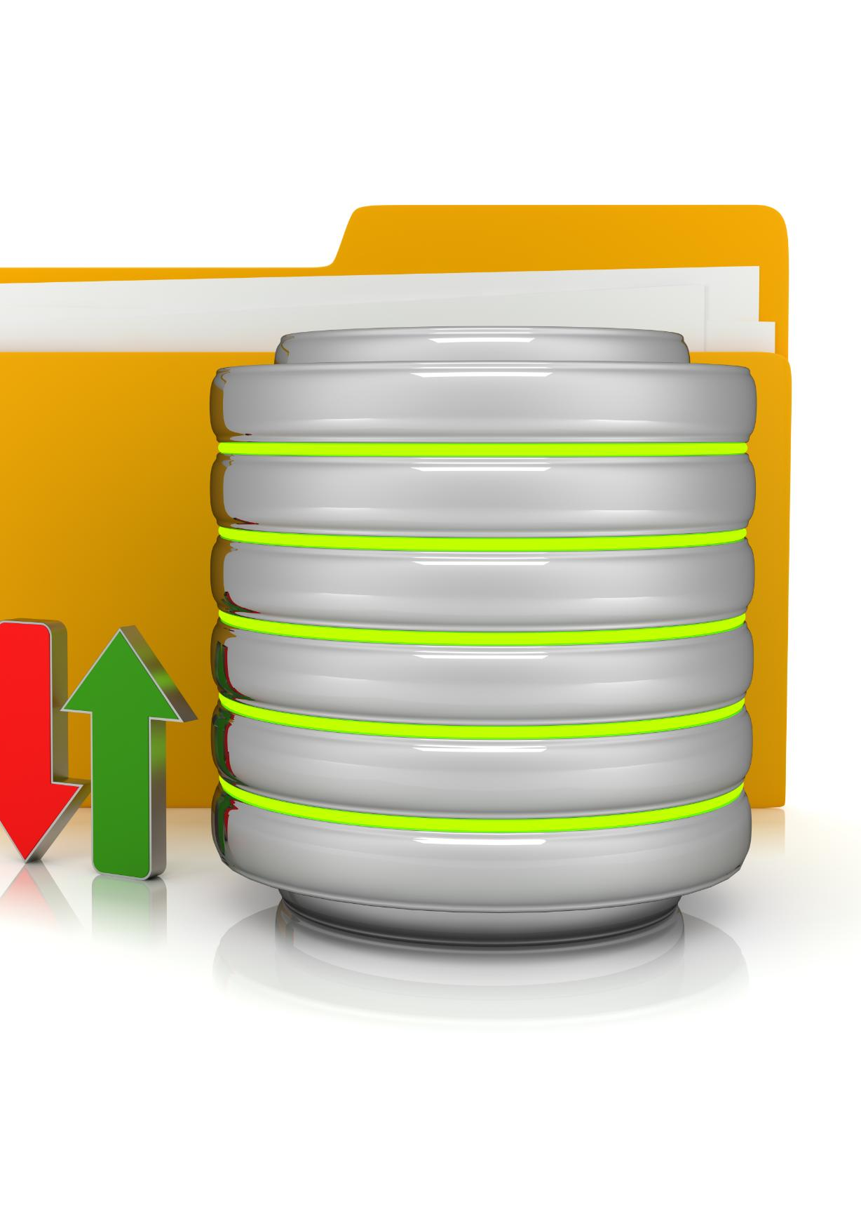
Converting Between Data Formats
Data Format Conversion
  Converting between data formats is a crucial aspect of data extraction. This process involves converting data from one format to another, such as from CSV to JSON or Excel to SQL.
SQL for Data Conversion
  SQL can be used to convert data between different formats. For example, you can use the SQL SELECT statement to retrieve data from a database and then use the INSERT statement to insert that data into another table or file format.
Third-Party Tools for Data Conversion
  Third-party tools can also be used for data conversion. These tools include ETL (Extract, Transform, Load) tools, data conversion software, and APIs (Application Programming Interfaces) for data conversion.
Notes:
Converting between data formats is a common task in data extraction. In this section, we will explore how to convert between common data formats, including using SQL and third-party tools.

Slide 12

Handling Inconsistent or Incomplete Data
Data Cleaning
  Data cleaning is the process of detecting and correcting or removing incomplete, incorrect, or irrelevant data from a dataset, which helps to improve the accuracy and quality of the data.
Data Normalization
  Data normalization is a process of structuring a database in accordance with a series of normal forms, which helps to reduce the redundancy and inconsistencies in the data.
Notes:
Inconsistent or incomplete data is a common challenge in data extraction. In this section, we will cover approaches to handling inconsistent or incomplete data, including data cleaning and data normalization techniques.

Slide 13
Conclusion
  Understanding the concepts of data extraction covered in this presentation will help you extract data more efficiently and effectively, while ensuring the accuracy and integrity of the extracted data.
Notes:
Data extraction is a critical process in data analysis and business intelligence. By understanding the concepts covered in this presentation, you will be able to extract data more efficiently and effectively, while ensuring the accuracy and integrity of the extracted data.

